Slide 1



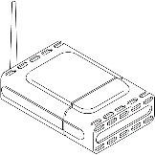


Router
cRIO
RaspPi
eth
Wifi
eth
CPU
I/O
I/O
eth
CPU
BT
FPGA

